Slide 1
EUROPEAN COFFEE MARKETS PAST PRESENT FUTURE

Slide 4
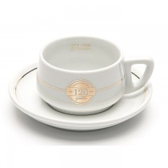

Slide 7
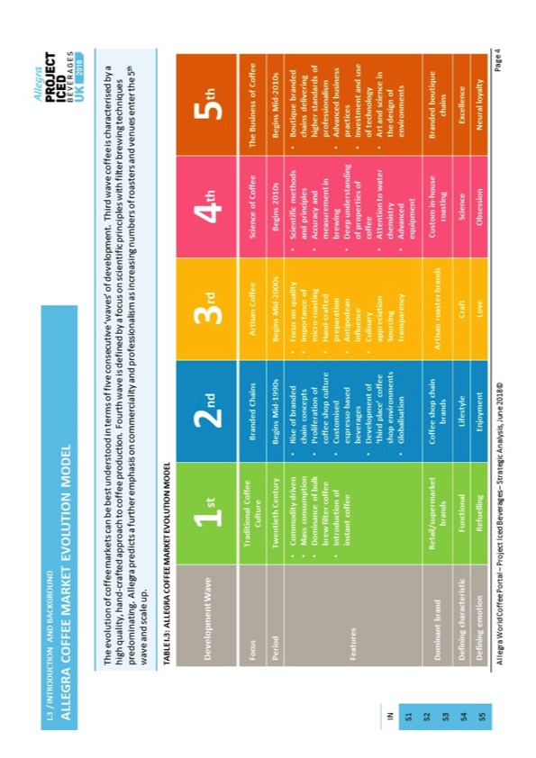

Slide 16
2.1.5 Market Overview – Market Size by Outlet Numbers / SECTION 2: MARKET
Market Size by Outlet Numbers
Allegra estimates that the total UK coffee shop market, including branded coffee chains, independents and non-specialist operators, reached 24,061 outlets in December 2017. This is an increase of 1,215 outlets, representing annual growth of 5.3%. Market growth was driven by branded coffee chains, adding 536 outlets over the last 12 months. Following compound annual growth of 7.7% between 2012 and 2017, Allegra predicts total market growth will continue at a more measured 5.5% per annum to surpass 31,400 outlets by 2022, driven by the branded chain and non-specialist segments.
FIGURE 2.1.1 – TOTAL NUMBER OF UK COFFEE SHOP OUTLETS BY TYPE, DEC 2007-DEC 2022F
No. of Outlets
Compound Annual Outlet Growth
Dec 17-Dec 22F
Total Market 5.5%
Non-Specialists
5.9%
Independents
4.1%
Branded chains
6.2%
9,906 | 10,566 | 13,522 | 14,390 | 15,366 | 16,636 | 17,711 | 19,469 | 21,625 | 22,846 | 24,061 | 25,499 | 26,968 | 28,430 | 29,918 | 31,419 | TOTAL
6.3% | 6.7% | 28.0% | 6.4% | 6.8% | 8.3% | 6.5% | 9.9% | 11.1% | 5.6% | 5.3% | 6.0% | 5.8% | 5.4% | 5.2% | 5.0% | YOY Growth
Notes: Non-specialist segment includes department stores, supermarkets, retail, pubs & hotels, quick service restaurants and motorway & forecourts and excludes branded chains coffee shops included in the branded segment but includes those with foodservice concepts such as Costa Proud to Serve or Starbucks We Proudly Serve.
Source: Allegra World Coffee Portal Research and Analysis, 2017

Slide 18
CONSUMPTION IN PRODUCING COUNTIRES
Coffee year |  |  |  |  |  | % change
(October to September) | 2014 | 2015 | 2016 | 2017 | 2018* | 17/18 to 18/19
PRODUCTION | 149 932 | 156 153 | 157 402 | 166 040 | 168 547 | 1.5%
Arabica | 87 064 | 93 402 | 99 676 | 101 032 | 103 714 | 2.7%
Robusta | 62 902 | 62 751 | 57 726 | 65 008 | 64 869 | -0.2%
Africa | 15 983 | 15 734 | 16 718 | 17 497 | 17 740 | 1.4%
Asia & Oceania | 46 274 | 49 323 | 45 299 | 49 156 | 48 177 | -2.0%
Mexico & Central America | 17 188 | 17 237 | 20 466 | 21 828 | 21 715 | -0.5%
South America | 70 486 | 73 859 | 74 919 | 77 559 | 80 915 | 4.3%
CONSUMPTION | 151 223 | 155 443 | 157 768 | 161 379 | 164 861 | 2.2%
Exporting countries | 46 505 | 47 500 | 48 458 | 49 605 | 50 257 | 1.3%
Importing countries | 104 718 | 107 943 | 109 310 | 111 774 | 114 604 | 2.5%
Africa | 10 719 | 10 951 | 10 767 | 10 895 | 11 167 | 2.5%
Asia & Oceania | 31 950 | 32 863 | 34 114 | 35 325 | 36 897 | 4.4%
Mexico & Central America | 5 230 | 5 295 | 5 174 | 5 257 | 5 266 | 0.2%
Europe | 51 008 | 52 147 | 52 043 | 52 996 | 53 703 | 1.3%
North America | 27 363 | 28 934 | 29 559 | 29 941 | 30 606 | 2.2%
South America | 24 954 | 25 251 | 26 111 | 26 964 | 27 222 | 1.0%
BALANCE | -1 291 | 711 | -366 | 4 662 | 3 686
ICO
Table 3: World supply/demand balance
In thousand 60-kg bags
*preliminary estimates

Slide 22
ICO composite indicator daily prices
140
135
130
125
120
115
110
105
100
95
90
Apr-17 Jul-17 Oct-17 Jan-18 Apr-18 Jul-18 Oct-18 Jan-19 Apr-19

Slide 23
СПАСИБО

